Slide 1
Networking Concepts Template
A Hyperlink Presentation
BY: Manvir, Dilpreet, Harkirat

Slide 2

Table of Contents
Some Useful Documentation
Some Basic Concepts
Web Servers & Web Pages
Domain Names & IP Addresses
Mail Servers & Other Types of Servers
Network Routing & ISPs
Local Area & Wide Area Networks & VPNs

Slide 3


1) Some Useful Documentation
How to use Hyperlinks in PowerPoint
https://www.ispringsolutions.com/blog/user-guide-for-non-linear-presentations
Home

Slide 4
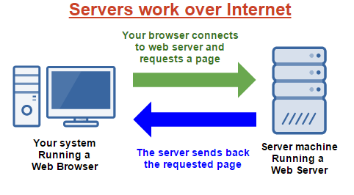

2) Some Basic Concepts
Section Topics
Client Server Model
Peer-To-Peer Model
Hyperlinks
Packets & Data
Firewalls
Basic Concepts
Home
Notes:
Manvir

Slide 5
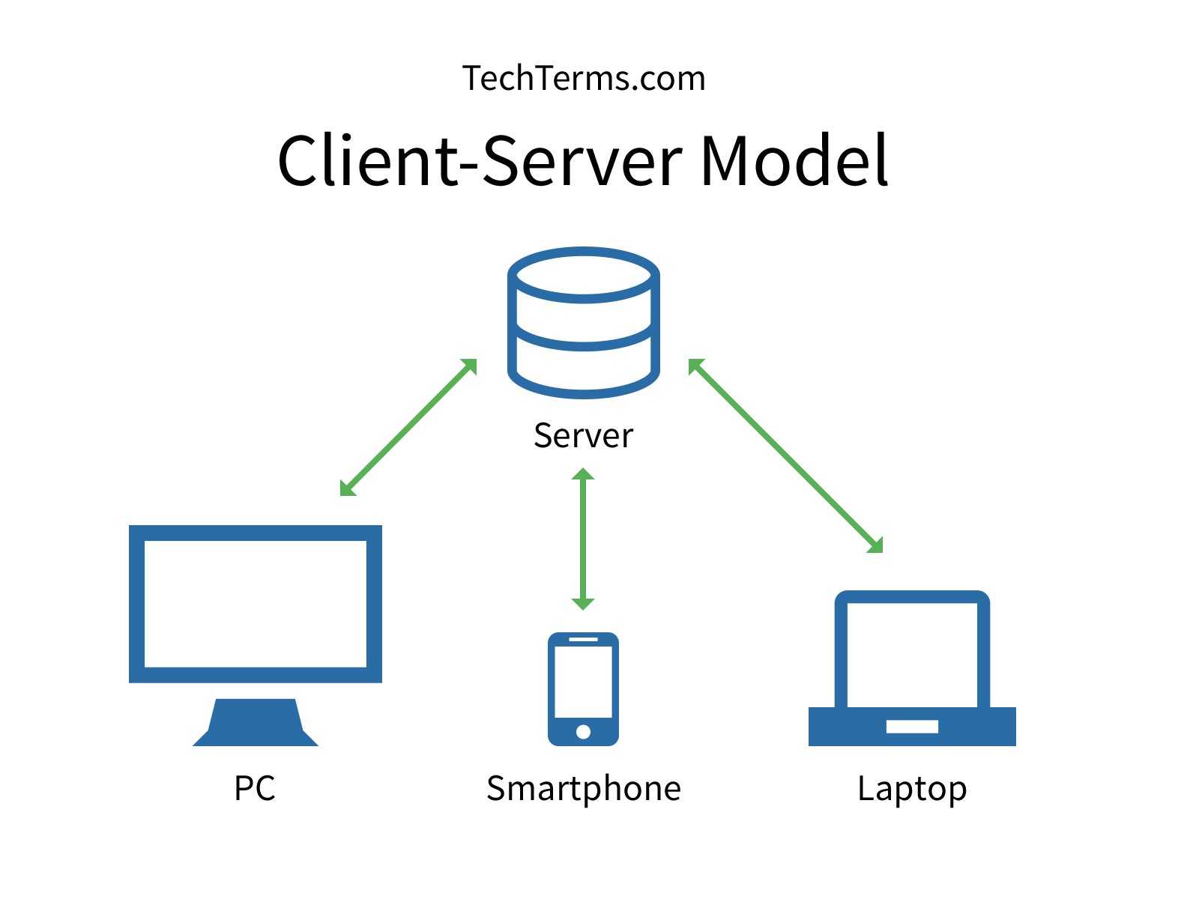
2.1) Client Server Model
Explain the Client Server Model
What is the Client
A computer or workstation that is able to obtaining info/ applications from a server.
What is the Server
A computer or computer program that Handles passage to a centralized resource or service in a network.
Provide an example of an application that uses the Client Server Model
Google drive, Drop box, Gmail, Outlook, Fortnite, Minecraft
Basic Concepts
Home
Notes:
Manvir

Slide 6
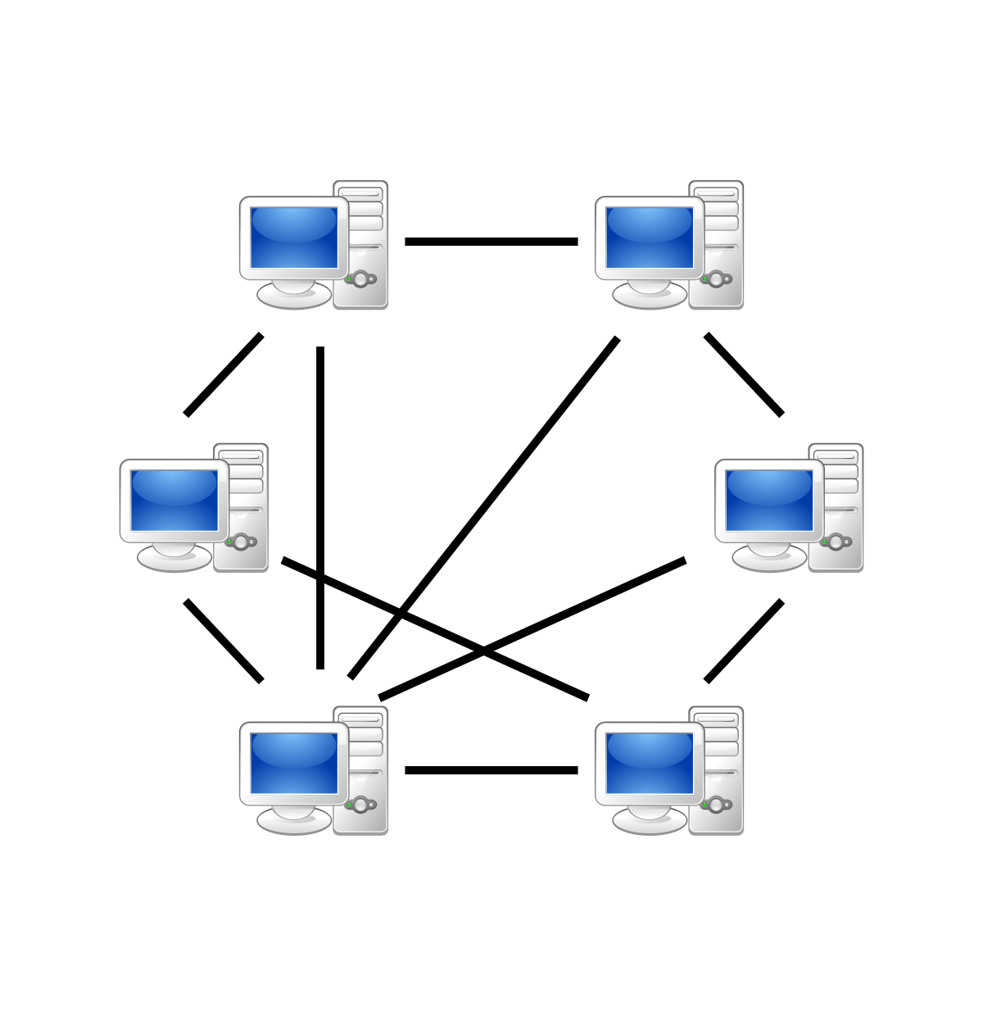
2.2) Peer-To-Peer Model
Explain the Peer-To-Peer Model
What is a Peer
A Peer is a computer systems that are connected to each other via the Internet. Files can be shared directly between these systems thru the network due to this there is no need for a central server.
How is it different from a Client Server Model
The main difference between the two is that in Client-Server model, the data management is centralised whereas, in the Peer-to-Peer model each user has its own data and applications.
Provide an example of an application that uses the Peer-To-Peer Model
Skype, LimeWire, Bittorent
Basic Concepts
Home
Notes:
Manvir

Slide 7
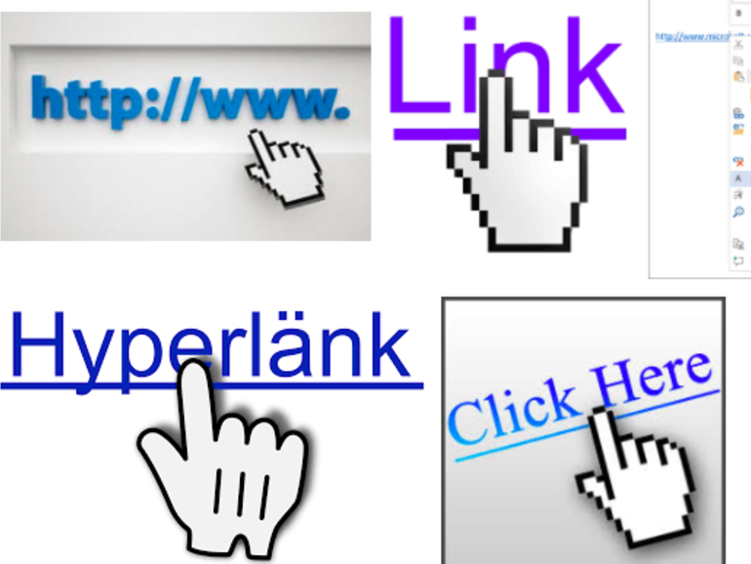
2.3) Hyperlinks
What is a Hyperlink?
A hyperlink is text or an image within a file on your computer that you can click on that gives access to another document or image.
How are Hyperlink related to Web Pages?
Hyperlinks are tools to take you from a web page to another Webpage
How are Hyperlinks related to this PowerPoint document?
Hyperlinks are tools to take you from a slide in the powerpoint to another slide
Basic Concepts
Home
Notes:
Manvir

Slide 8
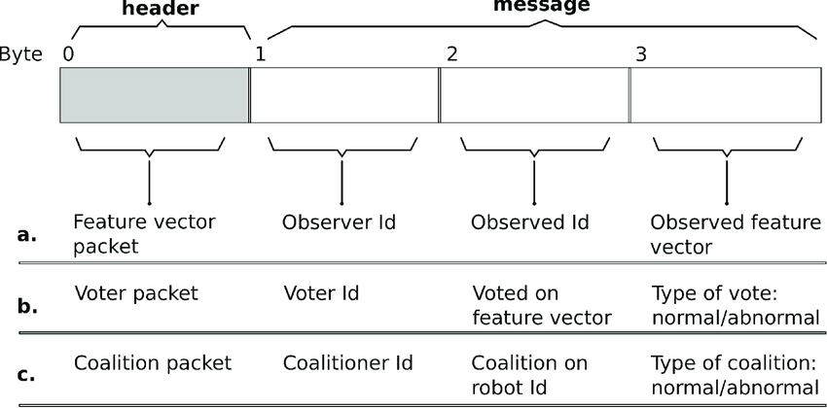
2.4) Packets & Data
What is a Data Packet? A data packet is a unit of data made into a single package that travels along a given network path.
What happens to a message (or data) when it is sent across the Internet?
Data travels across the internet in packets. Each packet can carry a maximum of 1,500 bytes. Around these packets is a wrapper with a header and a footer. The information contained in the packets tells the computers what kind of data is in the packet, how it fits together with other data, where the data came from and the data's final destination.
Basic Concepts
Home
Notes:
Manvir

Slide 9
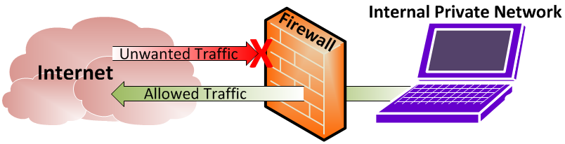
2.5) Firewalls
What is a Firewall?
A firewall is a system designed to prevent unauthorized access to or from a private network connected to the internet, especially intranets. There are two types of firewalls one is hardware and the other is software you can use one or both.
How does a Firewall protect your computer?
The firewall program or hardware device that filters the information coming through the Internet connection into your private network or computer system. If an incoming packet of information is flagged by the filters, it is not allowed through.
How does a Firewall protect remote servers?
The firewall system that provides network security filters incoming and outgoing network traffic based on a set of user-defined rules. In general, the purpose of the firewall is to reduce or eliminate the occurrence of unwanted network communications while allowing all legitimate communication to flow freely.
Basic Concepts
Home
Notes:
Manvir

Slide 10

THE END

Slide 11
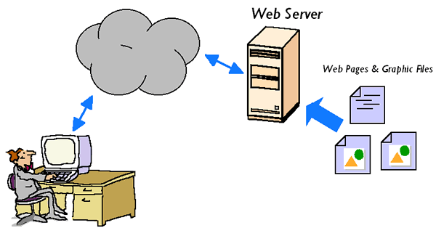

3) Web Servers & Web Pages
Section Topics
HTML
Browsing A Web Page
Web Client Hardware & Software
Web Server Hardware & Software
Web Servers
Home
Notes:
Manvir

Slide 12
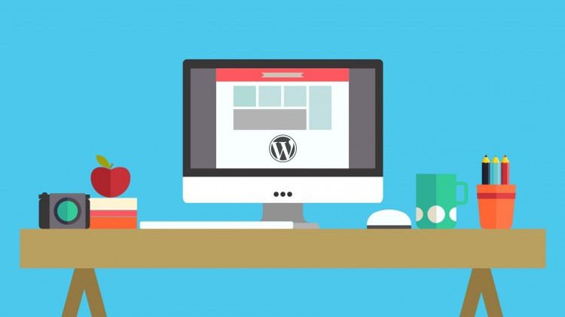

3.1) HTML & Web Pages
What does HTML stand for?
Hyper Text Markup Language
How is HTML related to Web Pages?
Hypertext Markup Language is the standard markup language for creating web pages and web applications.
What are some examples of HTML tags used in Web Pages?
<h1>,<h2>,<h3>,<h4>,<h5>, and <h6>
What are some other languages used in Web Pages?
JavaScript, Cascading Style Sheets and PHP: Hypertext Preprocessor
Web Servers
Home
Notes:
Manvir

Slide 13
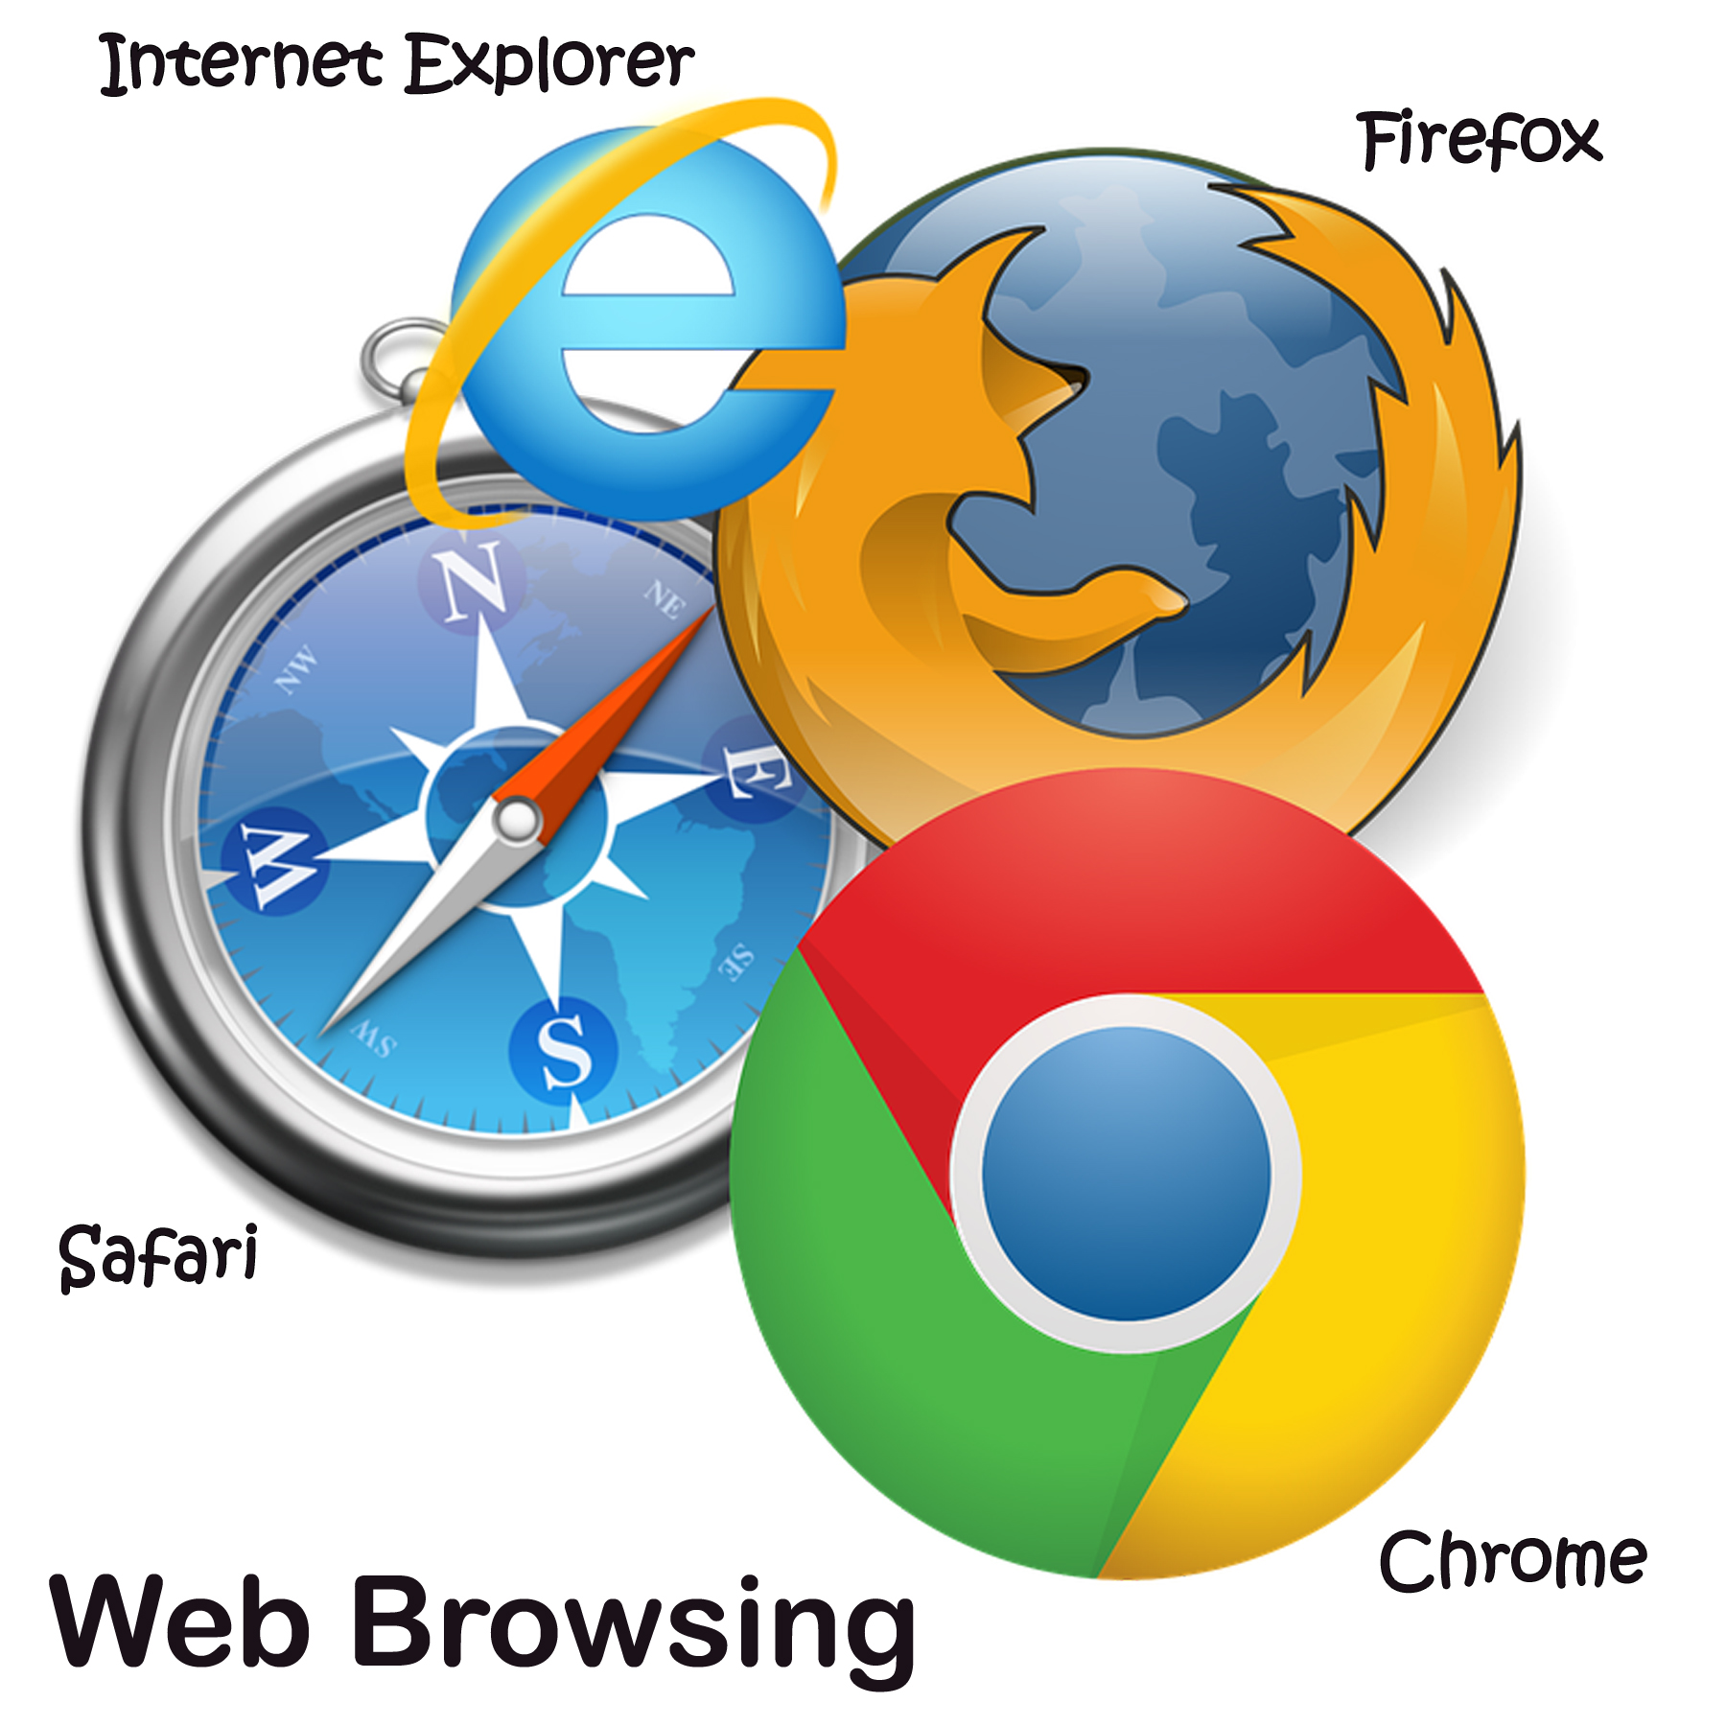
3.2) Browsing a Web Page
What happens when you browse a web page?
What are the main steps?
You enter a URL into a web browser.
The browser looks up the IP address for the domain name via DNS.
The browser begins rendering the HTML.
The browser sends requests for additional objects embedded in HTML (images, css, JavaScript) and repeats steps 3-5.
Web Servers
Home
Notes:
Manvir

Slide 14
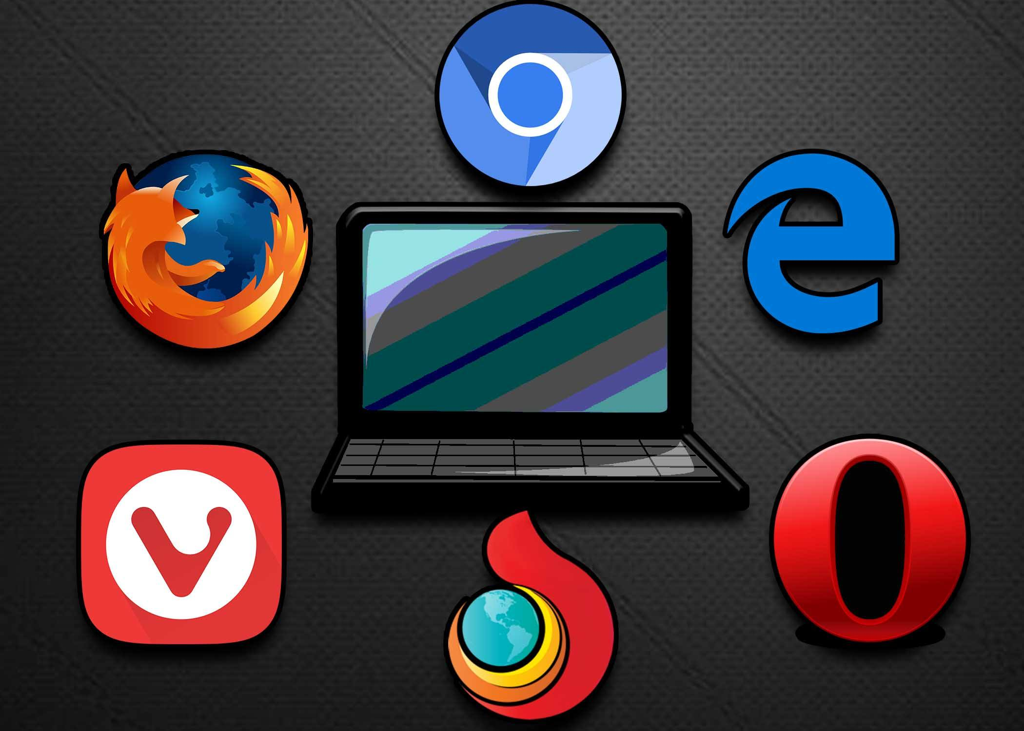
3.4) Web Client Hardware & Software
What does a Web Browser do?
A web browser (commonly referred to as a browser) is a software application for accessing information on the World Wide Web
What are some common web browsers?
The most popular browsers are Chrome, Firefox, Safari, Internet Explorer, and Edge.
How are they different?
-Speed
-Default in devices
-Simplicity
-Performance
-Security
-Reliability
-Privacy
-Web Standards
-Developer Tools
Web Servers
Home
Notes:
Manvir

Slide 15
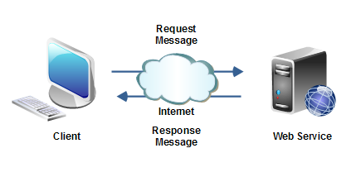
3.4) Web Client Hardware & Software (Continued part 1)
What are some other types of Web Clients?
Thick | A Thick client, also known as a rich client or fat client, is a client that performs the bulk of any data processing operations itself, and does not necessarily rely on the server. The personal computer is a common example of a fat client, because of its relatively large set of features and capabilities and its light reliance upon a server. For example, a computer running an Art program (such as Krita or Sketchup) that ultimately shares the result of its work on a network is a thick client. A computer that runs almost entirely as a standalone machine save to send or receive files via a network is by standard called a workstation.
Thin | A thin client is a minimal sort of client. Thin clients use the resources of the host computer. A thin client generally only presents processed data provided by an application server, which performs the bulk of any required data processing. A device using web application (such as Office Web Apps) is a thin client.
Hybrid | A hybrid client is a mixture of the above two client models. Similar to a fat client, it processes locally, but relies on the server for storing persistent data. This approach offers features from both the fat client (multimedia support, high performance) and the thin client (high manageability, flexibility). A device running an online version of the video game Diablo III is an example of hybrid client.
Web Servers
Home
Notes:
Manvir

Slide 16
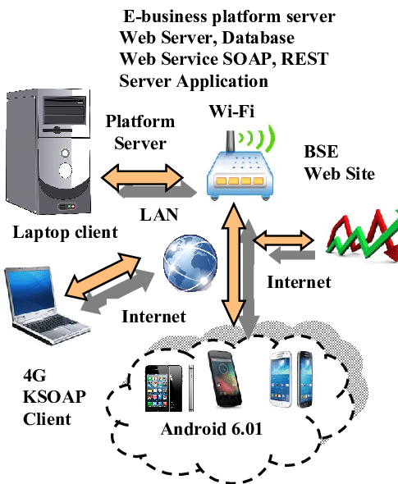
3.4) Web Client Hardware & Software (Continued part 2)
Is there any special Hardware or Software required to run a web client?
Hardware
High speed internet
Software
Browsers For Example:
-Chrome
-Firefox
-Safari
-Internet Explorer
-Edge.
Web Servers
Home
Notes:
Manvir No, Just No.

Slide 17

3.4) Web Server Hardware & Software
What does a Web Server do?
The primary function of a web server is to store, process and deliver web pages to clients. The communication between client and server takes place using the Hypertext Transfer Protocol (HTTP).
Where are Web Servers located in the Network / Internet?
The web servers ( and DB servers and Mail servers, media server etc.) of any organisation are generally hosted in a special facility called a data centre.
A Data Centre is a specialized facility to host computers and related components like network, storage & security devices .
A company may a hire a data centre or own one.
What special Software is needed for a Web Server
In order to set up a Web server, you need a dedicated computer (PC or Macintosh) running Windows/95, Windows/NT, or Linux or a Macintosh computer running MacOS. You also need a direct Internet connection and TCP/IP software. You can download shareware HTTP software for these platforms and operate your own Web server.
What special Hardware is needed for a Web Server
In order to set up a Web server, you need a dedicated computer (PC or Macintosh) running Windows/95, Windows/NT, or Linux or a Macintosh computer running MacOS. You also need a direct Internet connection and TCP/IP software.
Web Servers
Home
Notes:
Manvir

Slide 18


4) Domain Names & IP Addresses
Section Topics
What is a Domain Name?
What is an IP Address?
Controls the assignment of Names & Addresses?
Domain Names
Home
Notes:
Dilpreet

Slide 19
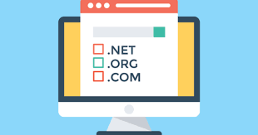
4.1) What is a Domain Name?
What is a Domain Name?
A domain name is a label that identifies a network domain: a distinct group of computers under a central administration or authority.
How are Domain Names related to Web Pages?
Domain names are used in URLs to identify particular Web pages.
How does my computer find and use Domain Names?
The domain name is one of the pieces inside of a URL. It is also the most easily recognized part of the entire address. When computer users type a web address directly into the field at the top of their browser window, it initiates a process of locating the page requested.
Domain Names
Home
Notes:
Dilpreet

Slide 20
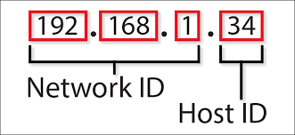
4.2) What is an IP Address?
What is an IP Address?
A unique string of numbers separated by periods that identifies each computer using the Internet Protocol to communicate over a network.
What is the difference between IPv4 and IPv6?
A 32-bit numeric address (IPv4) is written in decimal as four numbers separated by periods. IPv6 addresses are 128-bit IP address written in hexadecimal and separated by colons
How does my computer convert a Domain Name to an IP Address?
A domain name is associated with an IP Address automatically. The address cna change over time, and sometimes multiple addresses can be used to associate with a single domain name. The assignment of IP Addresses to a domain is done through the Domain Name System (DNS).
Domain Names
Home
Notes:
Dilpreet

Slide 21

4.3) Who Controls Domain Names?
Who Owns and Controls Domain Names and IP Addresses?
Whomever had first registered with that particular name or address.
How can I register a Domain Name for my own use?
You can register for your own domain name through applying through and paying a fee to the International Corporation for Assigned Names and Numbers.
Domain Names
Home
Notes:
Dilpreet

Slide 22


5) Mail & Other Servers
Section Topics
Mail Servers
File Servers
Database Servers
Other Types of Servers
Servers
Home
Notes:
Dilpreet

Slide 23
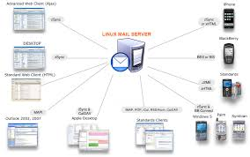
5.1) Mail Servers
Downloaded Mail
What is SMTP / POP3? Simple Mail Transfer Protocol and Post Office Protocol 3. They are protocols for computer mail servers in which they allow to send and receive emails among users.
What are some common Mail Clients? Examples: Outlook, Gmail, Samsung Mail, Etc.
What are some advantages of downloaded mail? Gives space on device solely meant for emails. Faster when accessing them.
Web Based Mail
What are some common Browser Based Mail Services? Yahoo, Gmail, Outlook, Etc.
What are some advantages of browser based mail? Mail is on a internet cloud based website which you can access anywhere, as long as you have an internet connection.
Mail Servers
Where is mail stored in the Internet? Mail is stored in Internet Message Access Protocol (IMAP) servers, which store them into local cache on your computer and then stored into pst-files.
How is mail delivered across the Internet? When you write an email, the mail client send that information to the SMTP client which downloads and processes the information, which it then sends again to the POP3 server so it can package and deliver to the receiver of the message.
What special Hardware & Software is required for a mail server? The hyperlink gives the required specs needed. http://www.helpmasterpro.com/helpfile/Common/html%20files/Hardware%20and%20Software%20Requirements%20-%20HelpMaster%20Email%20Manager.htm
Servers
Home
Notes:
Dilpreet

Slide 24
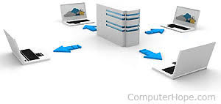
5.2) File Servers
Cloud Based Storage
What are some Cloud Storage Services (applications)? Google Drive, Dropbox, iDrive, Nextcloud, Etc.
What are some advantages of cloud based storage over local storage? Cloud storage allows a person to access their files from any location as long as they have an internet connection. Local storage only allows access to files stored on that specific device.
File Servers
What special Hardware & Software is required for a file server? The hyperlink gives the required specs needed. https://info.pleasantsolutions.com/Documentation/Pleasant_Password_Server/A._Install_Pleasant_Password_Server/Hardware_and_Software_Requirements
Servers
Home
Notes:
Dilpreet

Slide 25
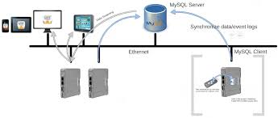
5.3) Database Servers
What is a Database?
What is SQL? Structured Query Language is a domain-specific language used in programming and designed for managing data held in a relational database management system, or for stream processing in a relational data stream management system.
What type of information is stored in a database? Data pertaining the the databases specific databases purpose. Such as academic articles being on a research database. Or entertainment based data on video sharing website.
How are databases used and combined with web pages? Web pages allow for the data base to display the information it had, allowing for users to navigate through the data and find the one which is useful in particular to them.
Database Servers
What are some common Database products? Oracle RDBMS, IBM DB2, Microsoft SQL Server, Etc.
What special Hardware & Software is required for a database server? https://docs.sdl.com/LiveContent/content/en-US/SDL%20WorldServer-v1/GUID-21F77A1D-1F2A-4762-BA68-BB18DE627DE8
Servers
Home
Notes:
Dilpreet

Slide 26
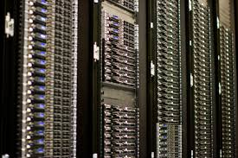
5.4) Other Servers
Describe some other types of internet servers not covered by the slides above:
Proxy Server - a server that acts as an intermediary for requests from clients seeking resources from other servers.
Server Platforms - A family of servers that includes the hardware and operating system
Web Server - is server software, or hardware dedicated to running said software, that can satisfy World Wide Web client requests.
Application Server - a software framework that provides both facilities to create web applications and a server environment to run them.
Real-Time Communication Server - a term used to refer to any livetelecommunications that occur without transmission delays.
FTP Server - s built on a client-server model architecture using separate control and data connections between the client and the server.
Collaboration Server - Collaboration is a unique feature in the Stellent products, allowing users to create, manage, and modify projects within the Content Server.
Servers
Home
Notes:
Dilpreet

Slide 27
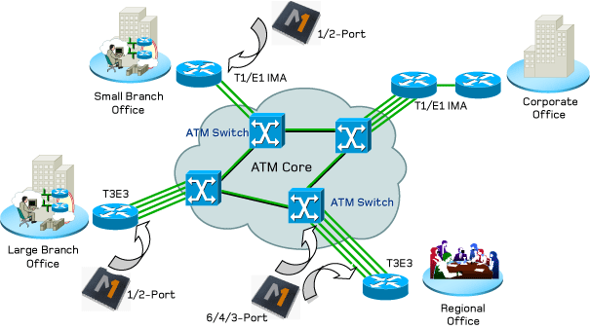

6) Network Routing & ISPs
Section Topics
Internet Service Provider (ISP)
Internet Connection Technologies
Network Routers & Switches
Networks
Home
Notes:
Harkirat

Slide 28
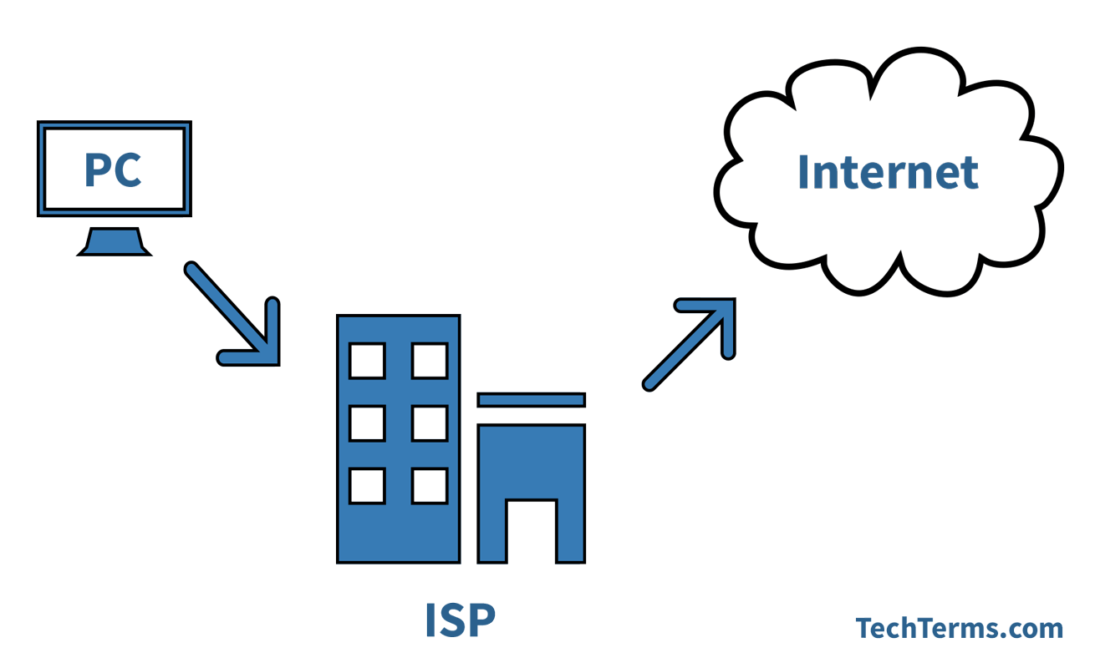
6.1) Internet Service Providers (ISPs)
What is an ISP?
An organization that provides access to the internet
What are some common ISPs people use in the Toronto Area?
Common ISPs in the Toronto Area are Rogers, Bell and Fido
How is an ISP different from a Internet application / service?
ISPs provide access to the internet while services and applications use internet.
Networks
Home
Notes:
Harkirat

Slide 29
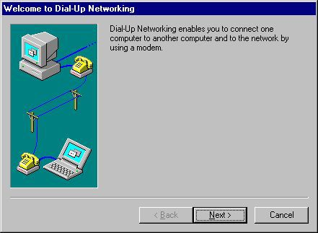
6.2) Internet Connection Technologies
Describe some internet connection technologies using telephone lines
Dial-up connections use your telephone line to access the internet
This technology has been most mostly replaced by broadband
Describe some internet connection technologies using Wi-Fi.
Wi-fi is a electromagnetic wave sent by a modem
These modems can be connected to by Wi-Fi or a Ethernet cable
Describe some internet connection technologies using fibre optics cables.
Fibre optic cables is a method of transmitting light through an optical fibre
This can be used to send information very fast through the cables
Networks
Home
Notes:
Harkirat

Slide 30
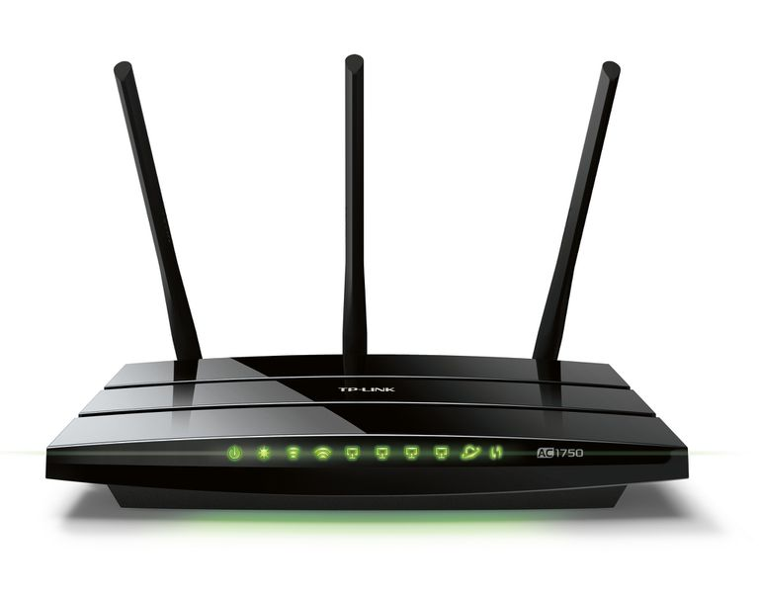
6.3) Network Routers & Switches
What is a "Routing Table"?
Routing tables determine which packets travelling over an IP network will be sent
Determine the best path for the packet to go towards their destination
How are data packets sent through the internet between a client and a server?
The client requests access to the server and it sends the client the packets
What special hardware & software is required for a network router / switch?
Routers are highly specialized computers with hardware to add speed to routing functions like forwarding packets
Special software like IPsec encryption
Networks
Home
Notes:
Harkirat

Slide 31
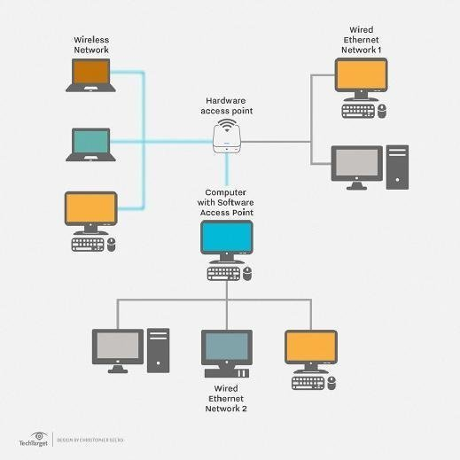
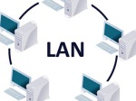
7) Types of Networks
Section Topics
Local Area Networks (LAN)
Wide Area Networks (WAN)
Virtual Private Networks (VPN)
LANs
Home
Notes:
Harkirat

Slide 32
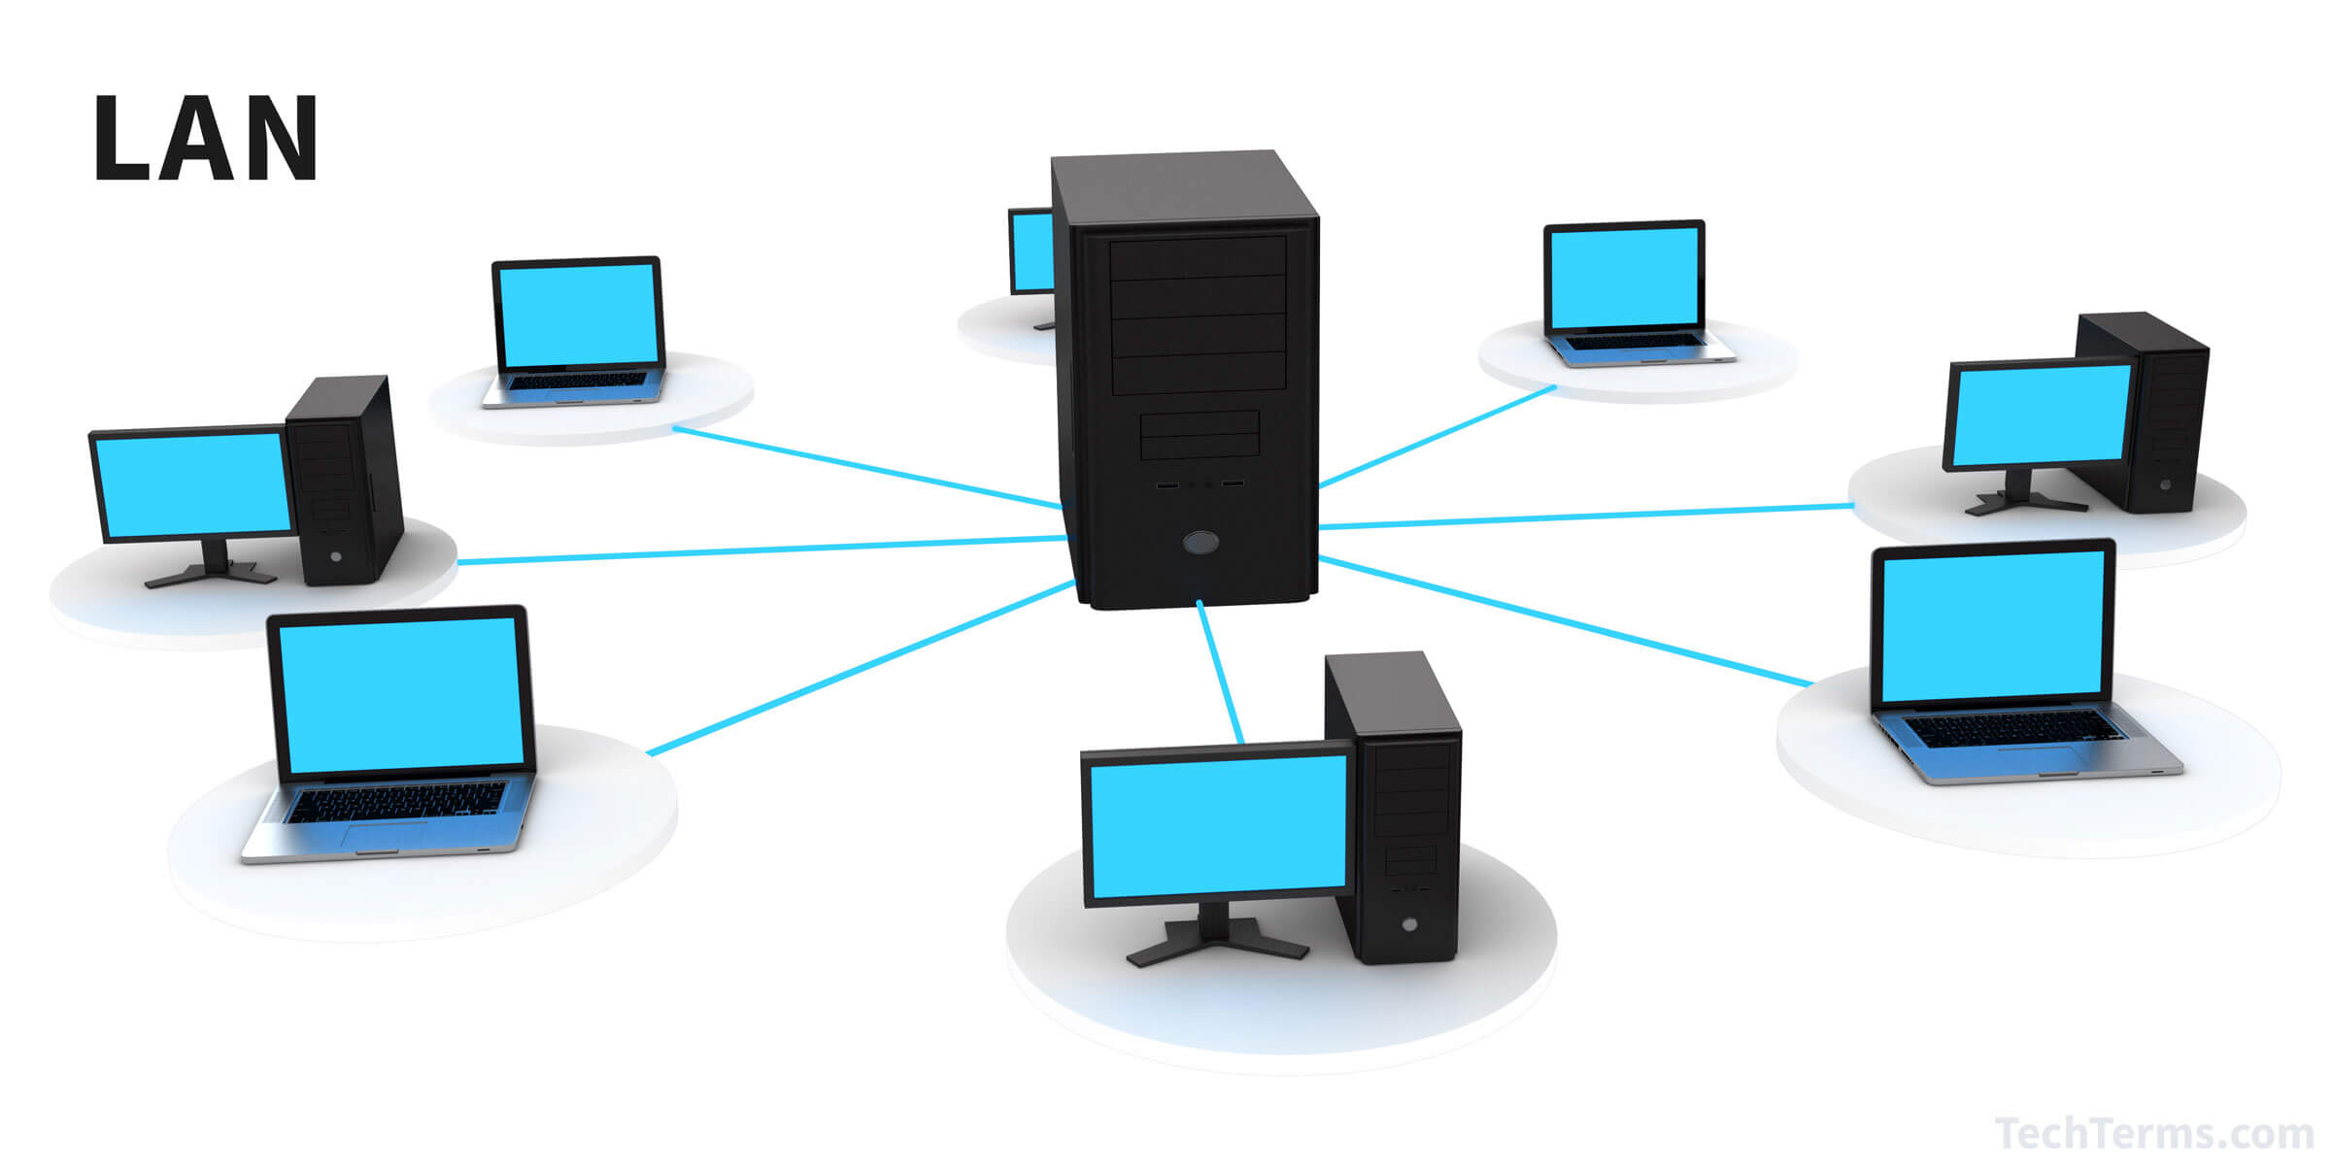
7.1) Local Area Networks (LAN)
What is a Local Area Network?
A Local Area Network is a computer network for a small area such as a house, school, campus, or office.
What is the purpose of a Local Area Network?
To provide high speed internet connections between local areas
What types of applications, servers, and computers are connected to a LAN?
School, Business and government servers are connected through LAN often
LANs
Home
Notes:
Harkirat

Slide 33
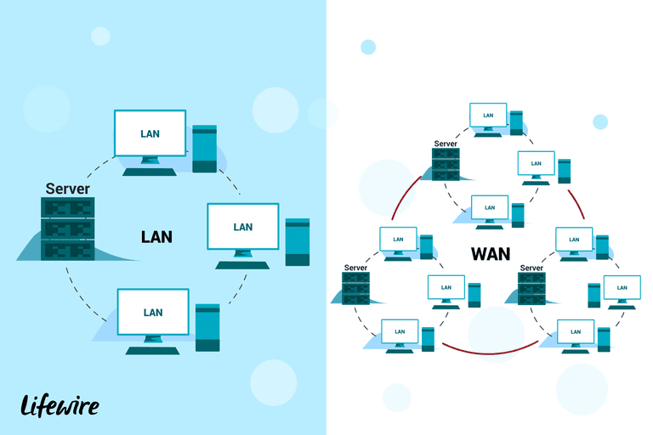
7.2) Wide Area Networks (WAN)
What is a Wide Area Network?
Computer network that stretches across a wide area of the
What is the purpose of a Wide Area Network?
So computers in different locations can communicate with each other
What types of applications, servers, and computers are connected to a WAN?
May be used for higher bandwidth applications
Business, Government and schools may be connected to a WAN.
LANs
Home
Notes:
Harkirat

Slide 34
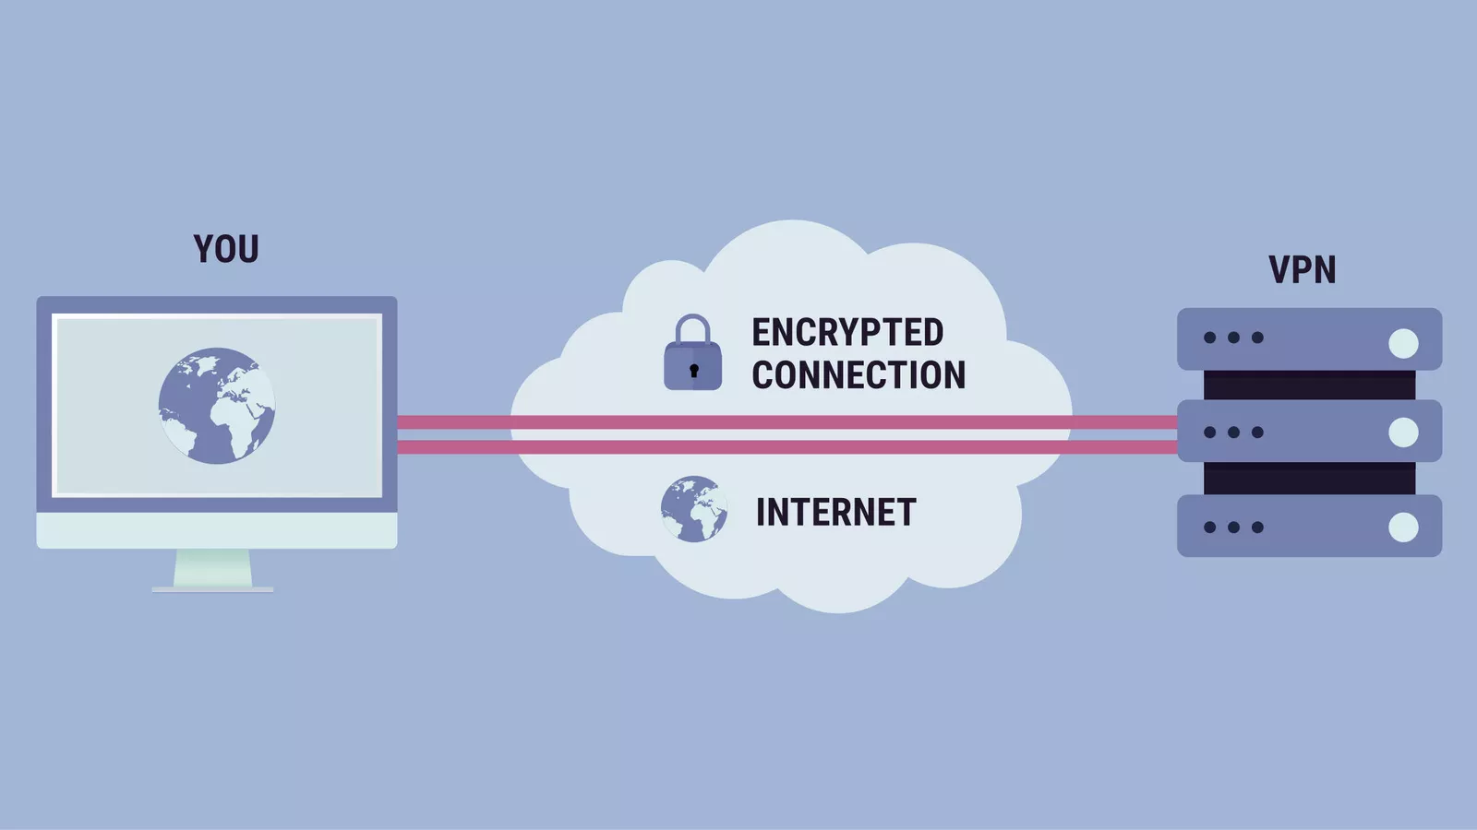
7.3) Virtual Private Networks (VPN)
What is a Virtual Private Network?
Extends a private network and lets users send or receive data as if they were directly connected to it
How is a VPN different from a LAN / WAN?
The device is not directly connected as they are in a local or wide area networks
How could you use a VPN to increase the security of services you use in the Internet?
By using a VPN you are hiding your location from other websites
LANs
Home
Notes:
Harkirat

Slide 35
Done by
Manvir:2,3,text and edit including titles, pictures, orange theme
Dilpreet: 4,5 editing and pictures
,Harkirat: 6,7, text, research, editing and pictures

